Slide 1
Sound Matching with a
Differentiable Karplus-Strong Algorithm
@DAFx26
Pablo Tablas de Paula, David Marttila, Rodrigo Mauricio Diaz,
Irán Román, Emmanouil Benetos & Joshua D. Reiss
Centre for Digital Music (C4DM), Queen Mary University of London

Slide 2
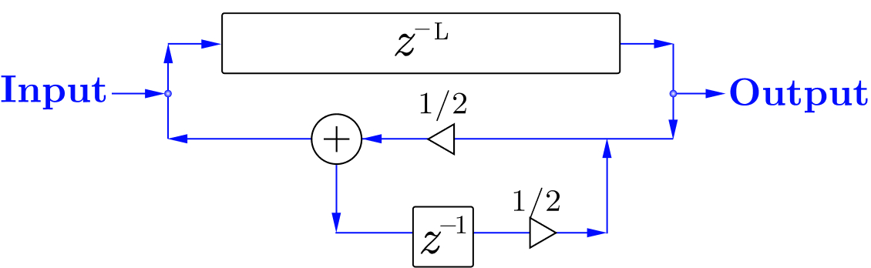
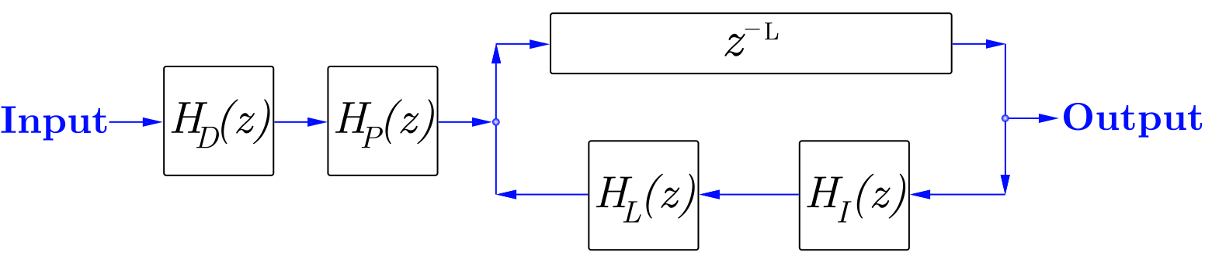
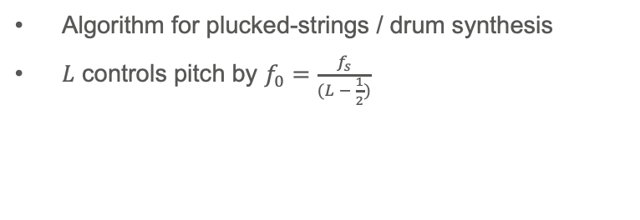
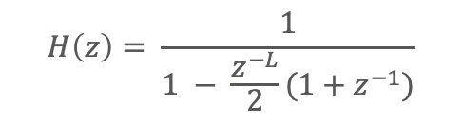
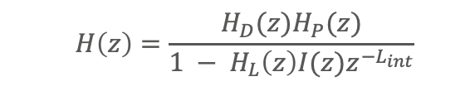
Karplus-Strong Algorithm
Algorithm for plucked-strings / drum synthesis
$L$ controls pitch by $f_{0}=\frac{f_{s}}{(L − \frac{1}{2})}$
$$H\left(z\right)= \frac{1}{1 − \frac{z^{−L}}{2}(1+z^{−1})}$$
Many extensions proposed
Independent control for:
Damping
Decay
Pluck Position
Dynamics
  $$H\left(z\right)=\frac{H_{D}(z)H_{P}(z)}{1 − H_{L}\left(z\right)I(z)z^{−L_{int}}}$$
K. Karplus and A. Strong, 1983. Digital Synthesis of Plucked-String and Drum Timbres. CMJ.
Jaffe, D.A. and Smith, J.O., 1983. Extensions of the Karplus-Strong (…) algorithm. CMJ
Välimäki, V. et al. 1996. Physical modeling of plucked string instruments (…). JAES.

Slide 3
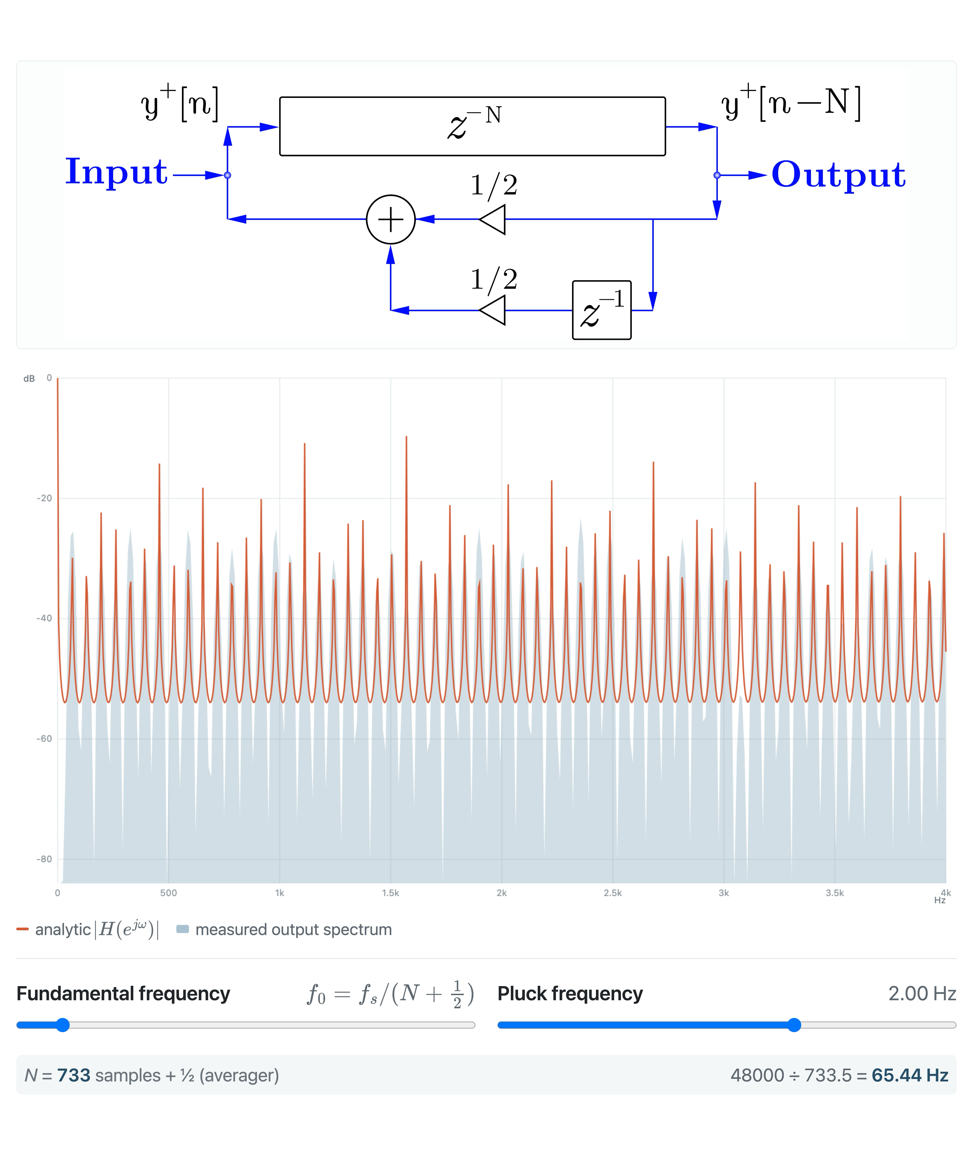
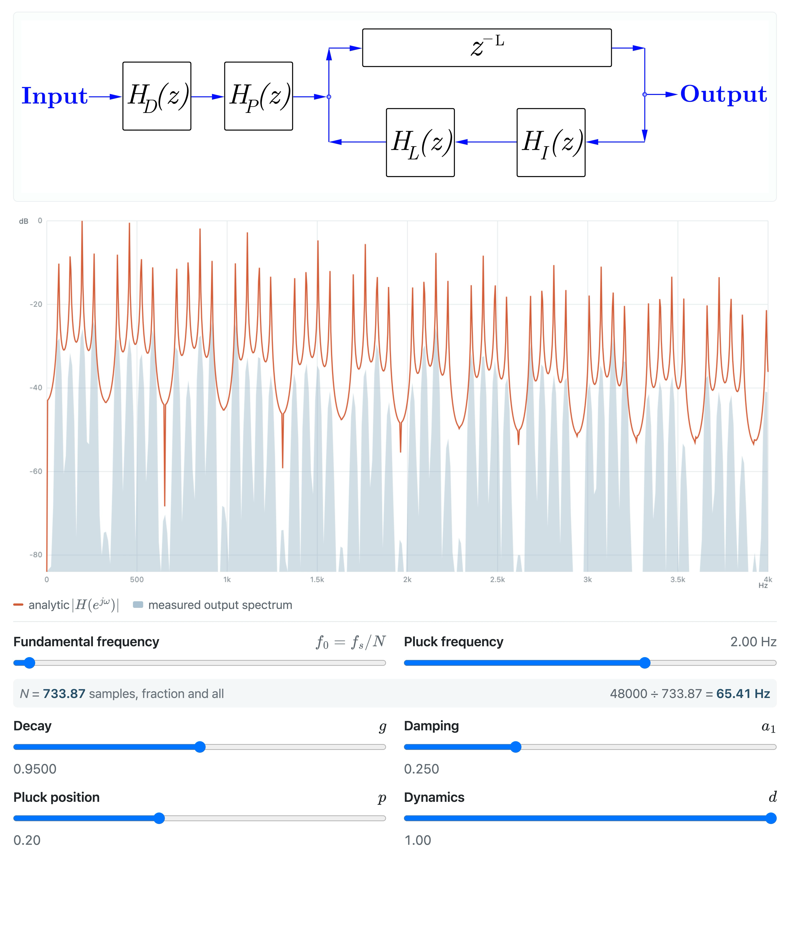
Karplus-Strong Algorithm
Extended Karplus-Strong Algorithm

Slide 4
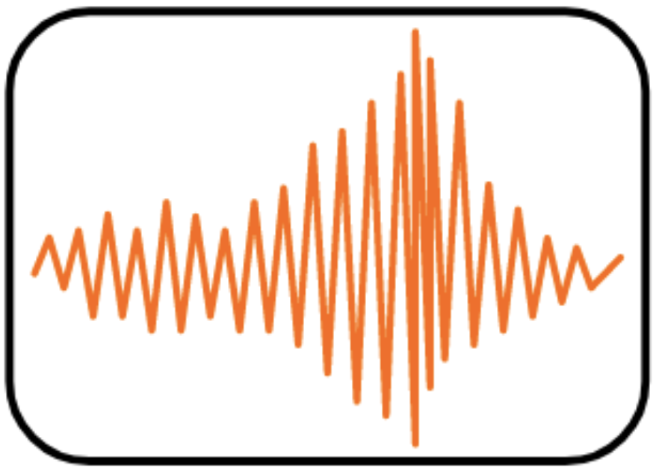
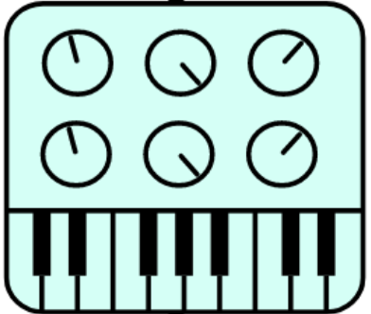
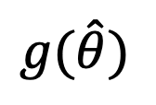
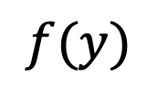
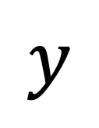
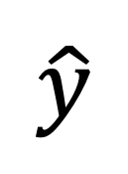
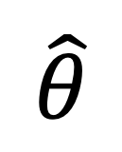
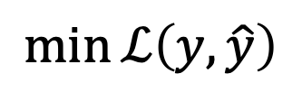
Synthesizer Sound Matching
$$f(y)$$
$$g(\hat{θ})$$
$$\hat{θ}$$
$$y$$
$$\hat{y}$$
$$\min{ℒ\left(y, \hat{y}\right)}$$
Efficiency: Karplus-Strong needs very few parameters to represent complex sounds.
Interpretability: the obtained parameters are psychoacoustic properties of a string.

Slide 5
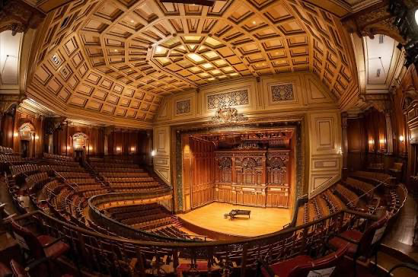
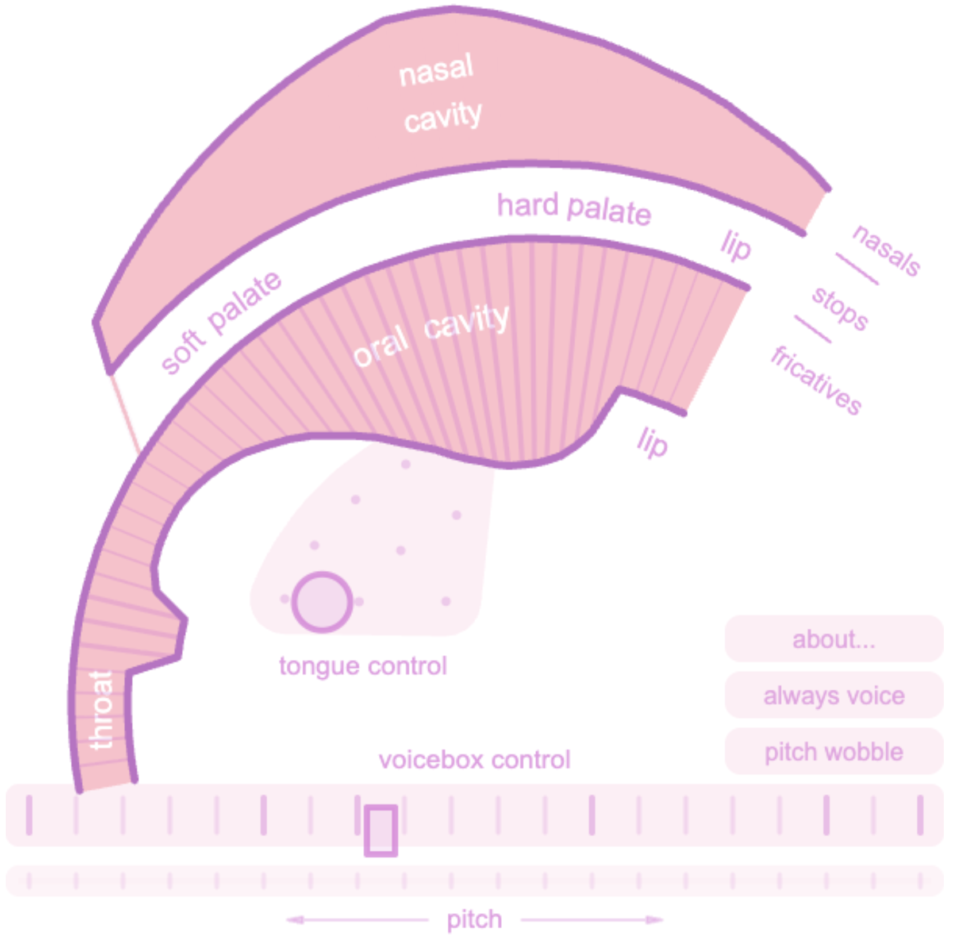
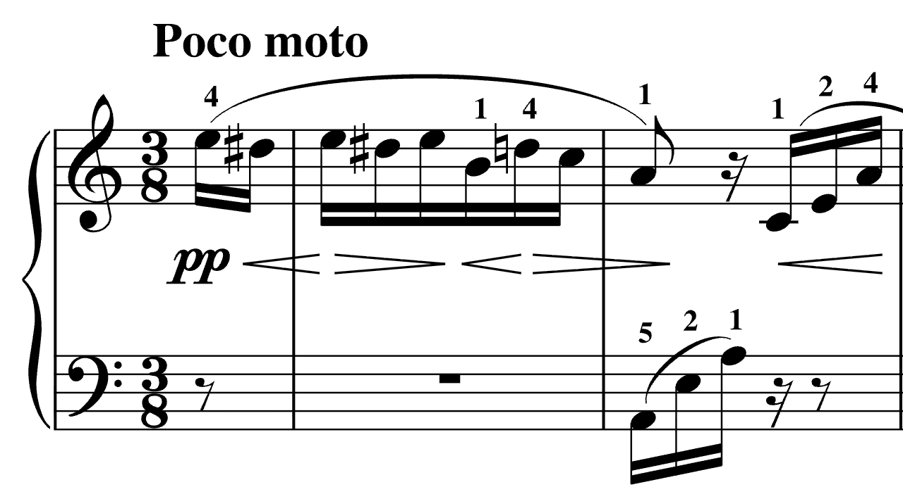
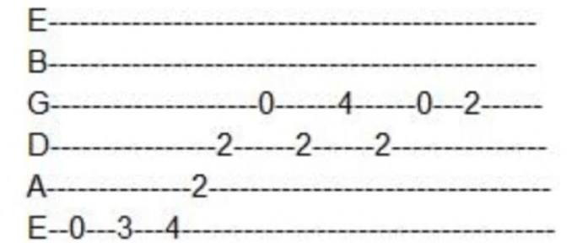
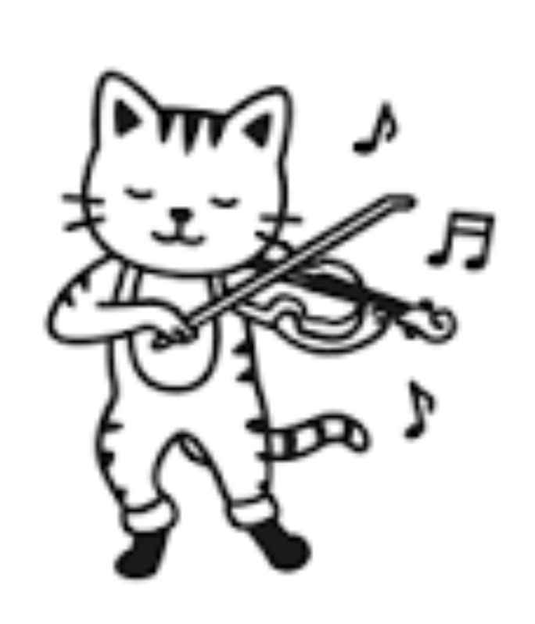
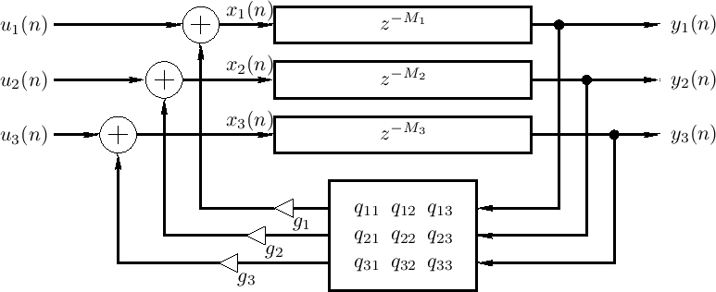
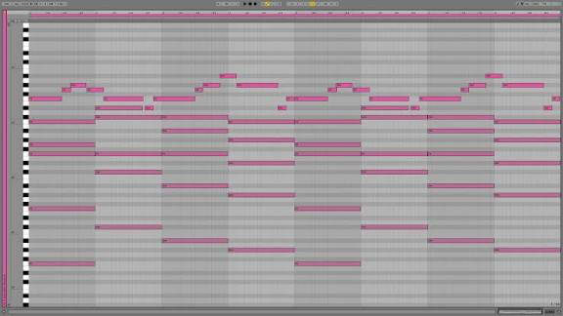
Units of Change
Impulse Response
no change
Events
low rate (e.g., 2-10 in 4s)
Frames
high rate (e.g., 62.5Hz)
time-invariant
time-varying
- degrees of freedom
Sweet spot for plucked/struck instruments
+ Expressivity
tone-matching
+ interpretable
performance
Closer to symbolic

Slide 6



Units of Change
$N$ events
$$θ_{N}∈\{exists, time, f_{0},timbre\}$$
$$exists∈\{0,1\}$$

Slide 7



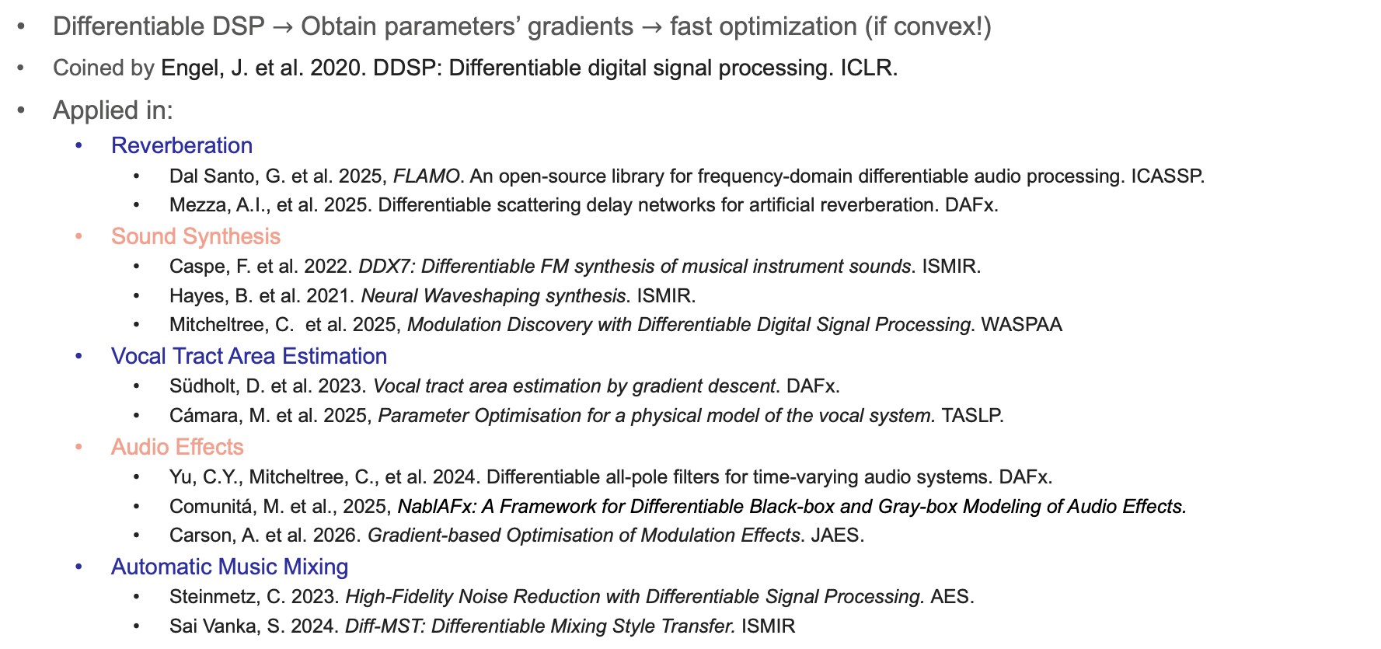
Differentiable Digital Signal Processing
Differentiable DSP $→$ Obtain parameters’ gradients $→$ fast optimization (if convex!)
Coined by Engel, J. et al. 2020. DDSP: Differentiable digital signal processing. ICLR.
Applied in:
  Reverberation
    Dal Santo, G. et al. 2025, FLAMO. An open-source library for frequency-domain differentiable audio processing. ICASSP.
    Mezza, A.I., et al. 2025. Differentiable scattering delay networks for artificial reverberation. DAFx.
  Sound Synthesis
    Caspe, F. et al. 2022. DDX7: Differentiable FM synthesis of musical instrument sounds. ISMIR.
    Hayes, B. et al. 2021. Neural Waveshaping synthesis. ISMIR.
    Mitcheltree, C. et al. 2025, Modulation Discovery with Differentiable Digital Signal Processing. WASPAA
  Vocal Tract Area Estimation
    Südholt, D. et al. 2023. Vocal tract area estimation by gradient descent. DAFx.
    Cámara, M. et al. 2025, Parameter Optimisation for a physical model of the vocal system. TASLP.
  Audio Effects
    Yu, C.Y., Mitcheltree, C., et al. 2024. Differentiable all-pole filters for time-varying audio systems. DAFx.
    Comunitá, M. et al., 2025, NablAFx: A Framework for Differentiable Black-box and Gray-box Modeling of Audio Effects.
    Carson, A. et al. 2026. Gradient-based Optimisation of Modulation Effects. JAES.
  Automatic Music Mixing
    Steinmetz, C. 2023. High-Fidelity Noise Reduction with Differentiable Signal Processing. AES.
    Sai Vanka, S. 2024. Diff-MST: Differentiable Mixing Style Transfer. ISMIR

Slide 8
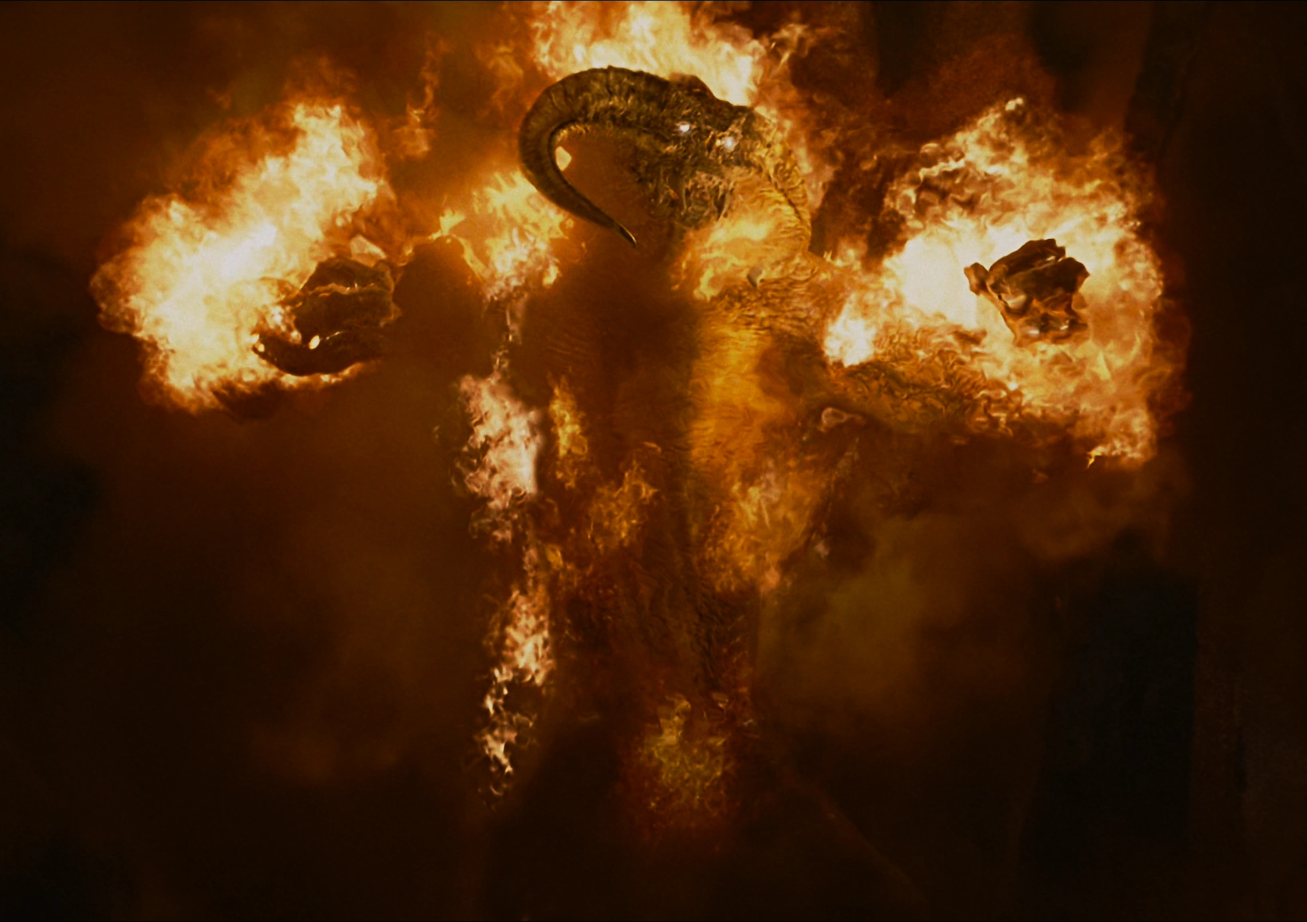
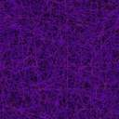
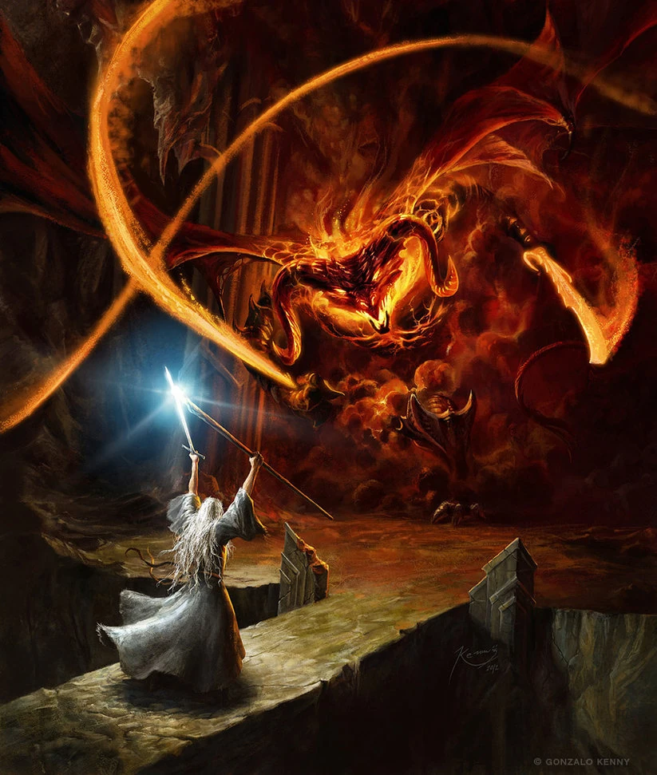
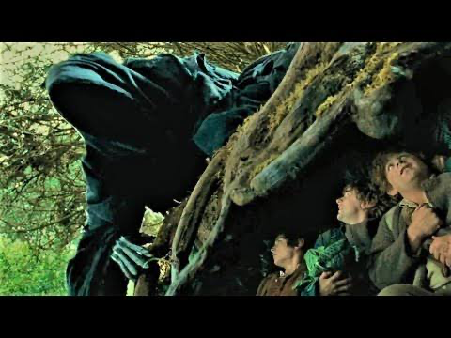

$$f_{0}$$
FLIGHT
FIGHT
External Detectors
Synthetic Supervision
Develop more helpful losses
Torres, B., et al. 2024, Unsupervised harmonic parameter estimation using DDSP and spectral optimal transport. ICASSP
Schwär, S. and Müller, M., 2023. Multi-scale spectral loss revisited. IEEE Signal Processing Letters

Slide 9



3 methods & 2 differentiable implementations
FLIGHT
Audio-Only:
  $f_{0}$ and onset detectors
  Audio losses for timbre
$℘$-Only
  MAE on parameters of synthetic data ($℘_{loss}$)
$℘$+Audio
  Combination of $℘_{loss}$ and audio losses
FIGHT
External Detectors
Synthetic Supervision
Develop more helpful losses
  Time-domain
  $tKSA\left(z\right)=\frac{H_{D}(z)H_{P}(z)}{1 − H_{L}\left(z\right)I(z)z^{−L_{int}}}$
  Frequency-domain
  $fKSA\left(z\right)=\frac{H_{D}(Z_{M})H_{P}(Z_{M})}{1 − H_{L}\left(Z_{M}\right)z_{M}^{−L} }$

Slide 10
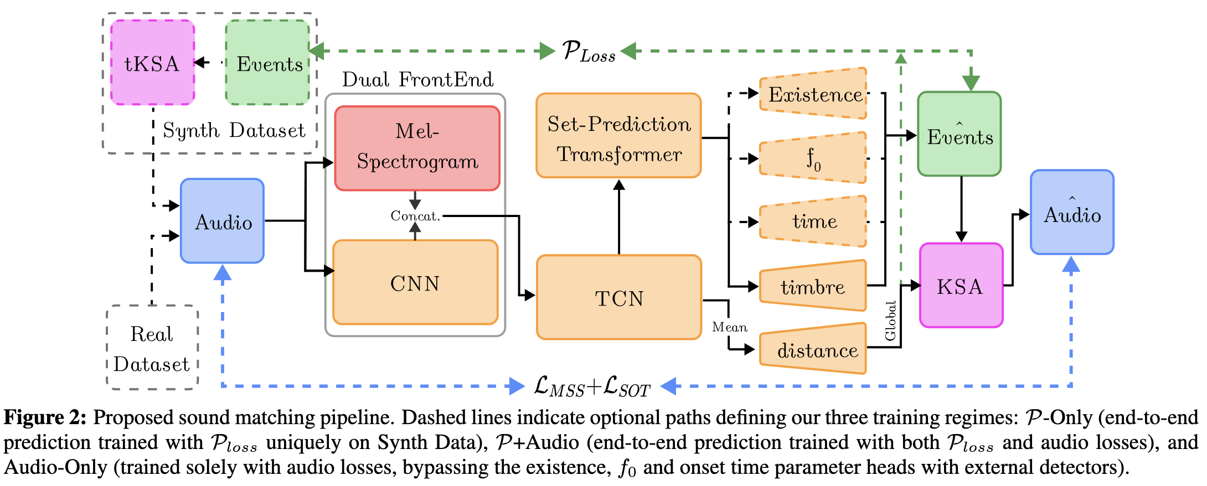
Neural Network

Slide 11
Results

Slide 12
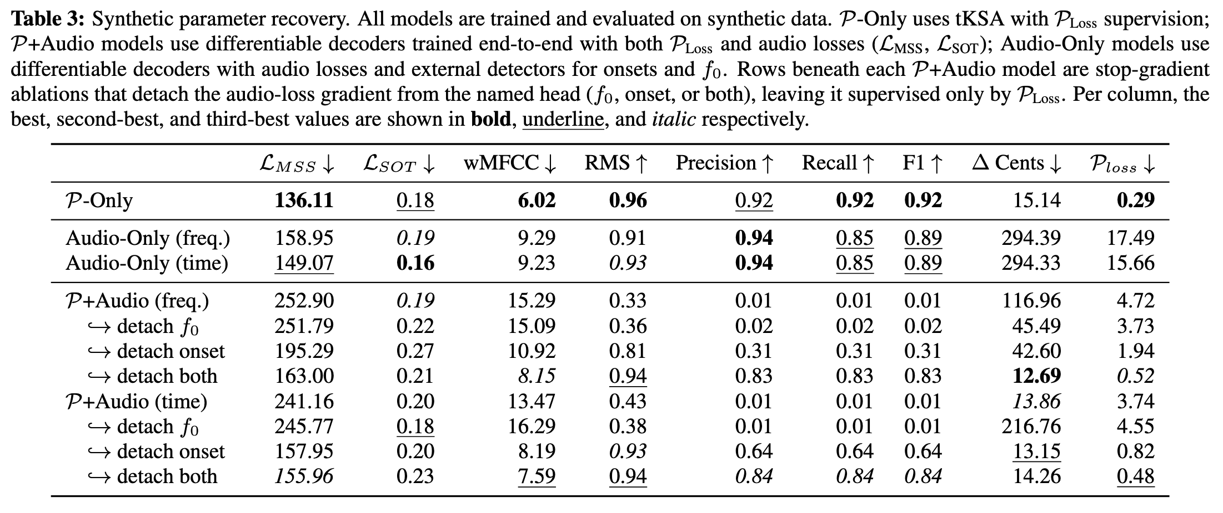
Synthetic Parameter Recovery

Slide 13
Synthetic Parameter Recovery
$℘$-Only good!

Slide 14
Synthetic Parameter Recovery
Audio-Only is good, but it suffers from octave errors and worse onset prediction

Slide 15
Synthetic Parameter Recovery
$℘$+Audio fails strenuously
Detaching audio losses improves $f_{0}$ and onset estimation!

Slide 16
Synthetic Parameter Recovery
The frequency sampling method is consistently worse

Slide 17
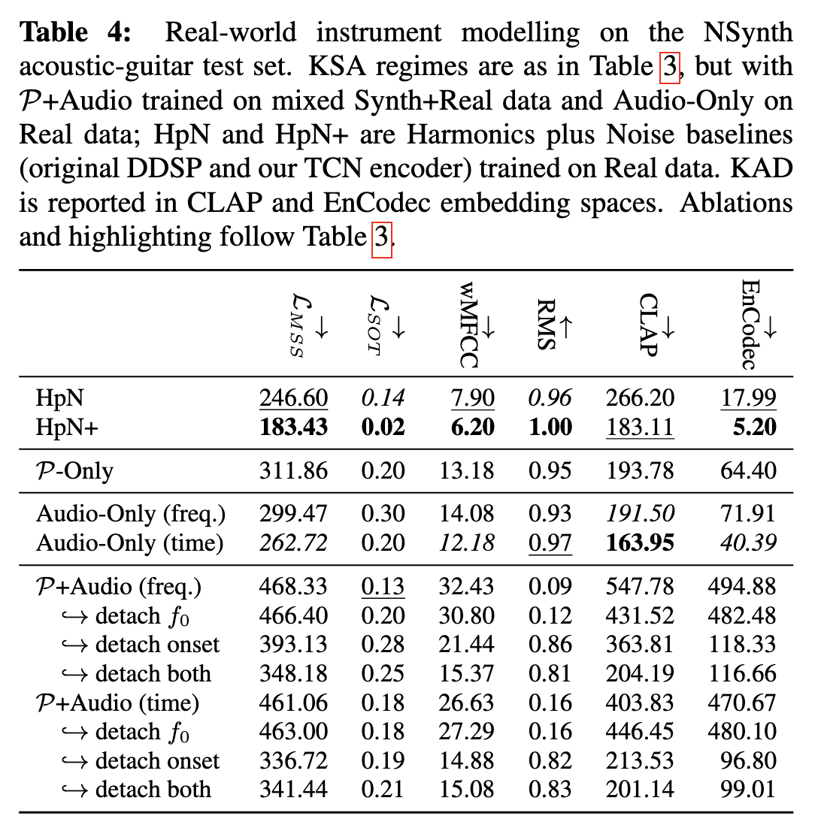
Real-World Instrument Modelling
Comparison against a Harmonics + Noise model
Audio losses are trained on training split of nsynth

Slide 18
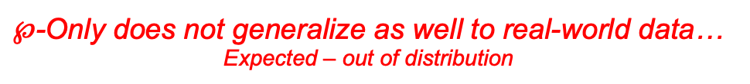
Real-World Instrument Modelling
Comparison against a Harmonics + Noise model
Audio losses are trained on training split of nsynth
$℘$-Only does not generalize as well to real-world data…
Expected – out of distribution

Slide 19
Real-World Instrument Modelling
Nsynth Acoustic Guitar Subset
Comparison against a Harmonics + Noise model
Audio losses are trained on training split of nsynth
$HpN$ wins on most metrics…
But time domain Audio-Only (w/ external detectors) is competitive with HpN

Slide 20
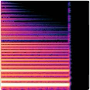
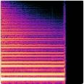
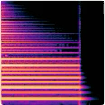
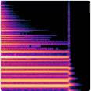
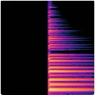
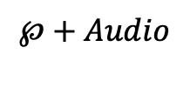
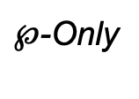
Real-World Instrument Modelling
Target (Nsynth)
Harmonics + Noise
$℘$-Only
Audio-Only
$$℘+Audio$$

Slide 21
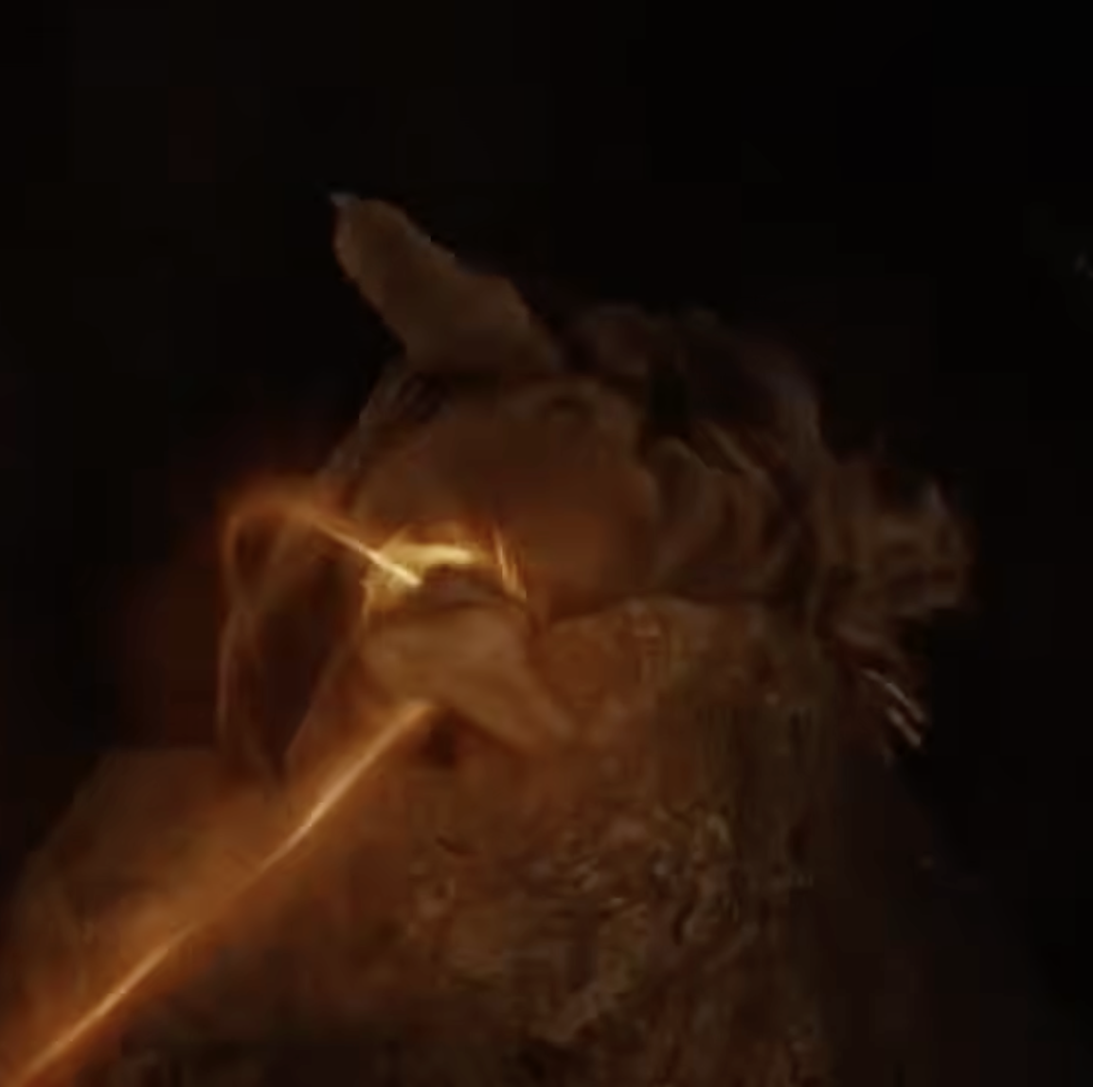
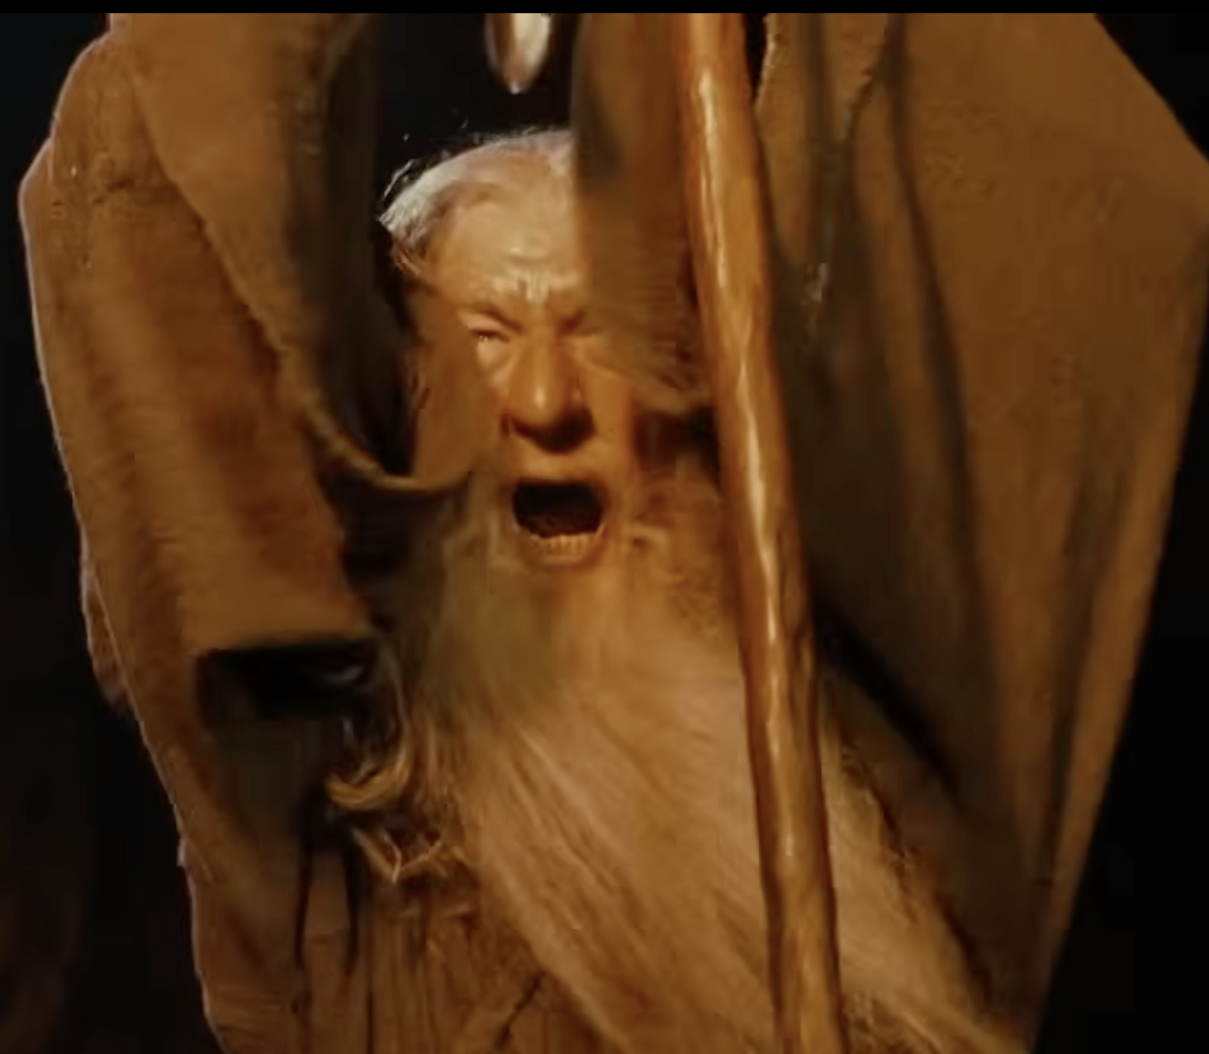
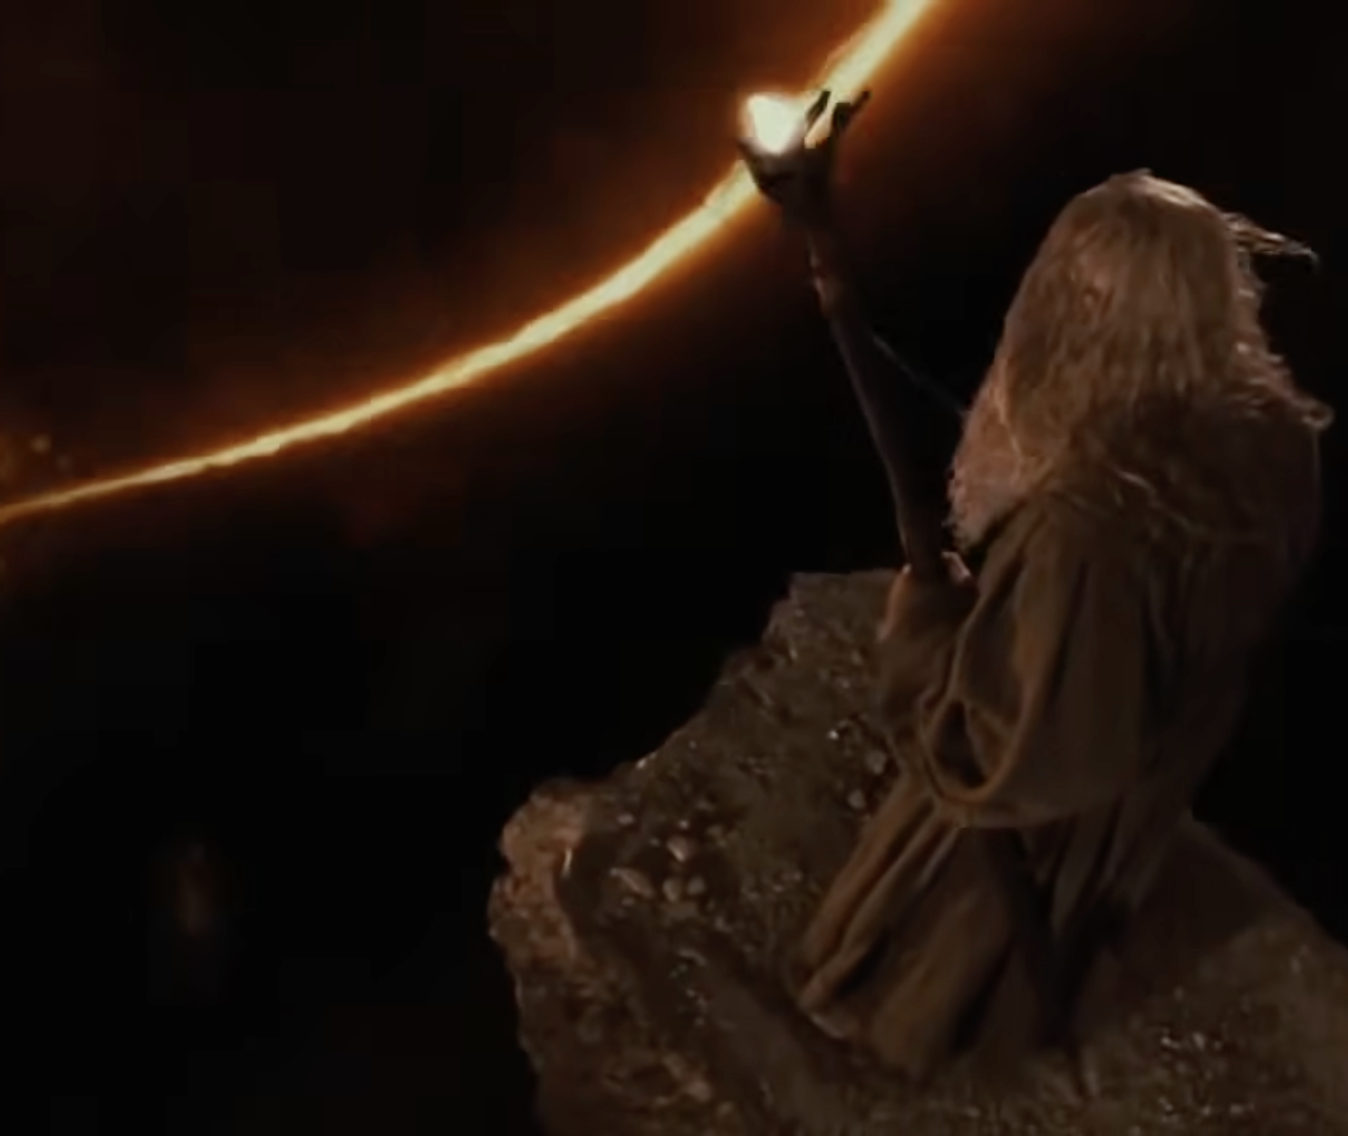
Spectral!!
Onset time
Optimal!!
Onset time!
Transport!

Slide 22
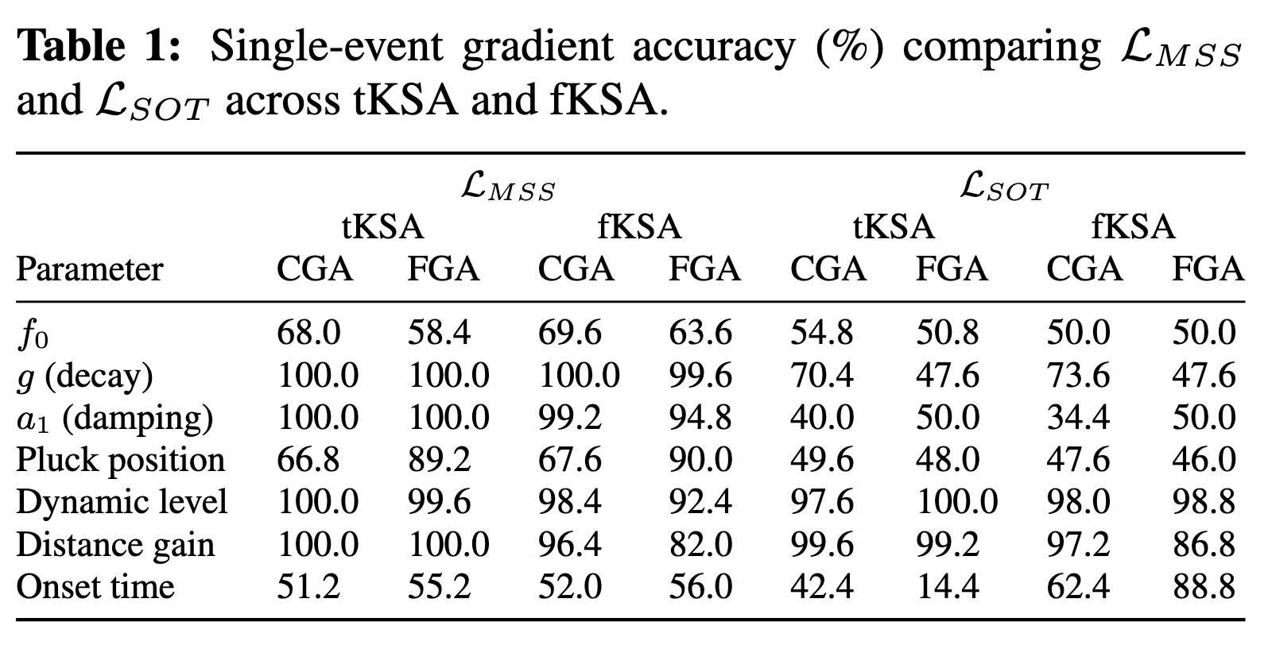
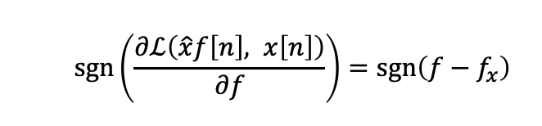

Gradient Analysis
  $$\operatorname{sgn}\left(\frac{∂ℒ\left(\hat{x}f\left[n\right], x\left[n\right]\right)}{∂f}\right)=\operatorname{sgn}\left(f−f_{x}\right)$$
$ℒ_{SOT}$ scores near chance
w.r.t. $f_{0}$!
Both scores near chance
w.r.t. Onset time!

Slide 23
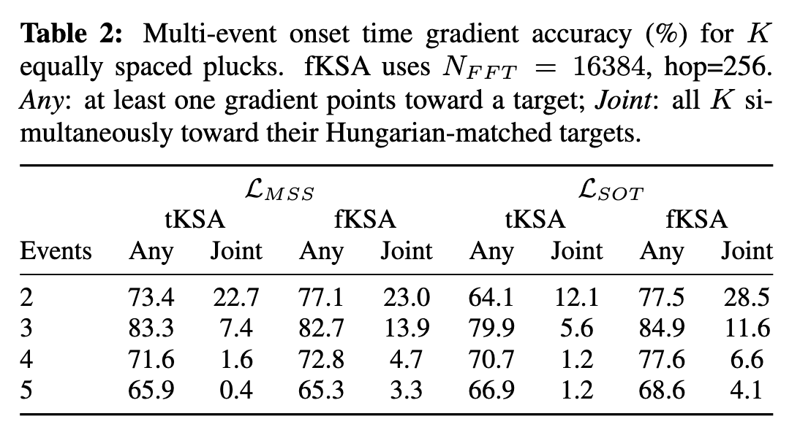
Gradient Analysis
The chance of any of the losses, simultaneously
Pointing at closest event is near zero

Slide 24
Key takeaways:
  We have developed a differentiable event-based sound-matching Karplus-Strong Algorithm for monophonic guitar
    Results show the event-based method is sensible
  Event-based prediction could unite sound matching with symbolic MIR
    For which physical modelling would be essential
  But it presents challenges for self-supervised audio loss optimization:
    Current losses do not provide good gradients w.r.t onset time
    A non-differentiable binary switch (to be or not be)

Slide 25
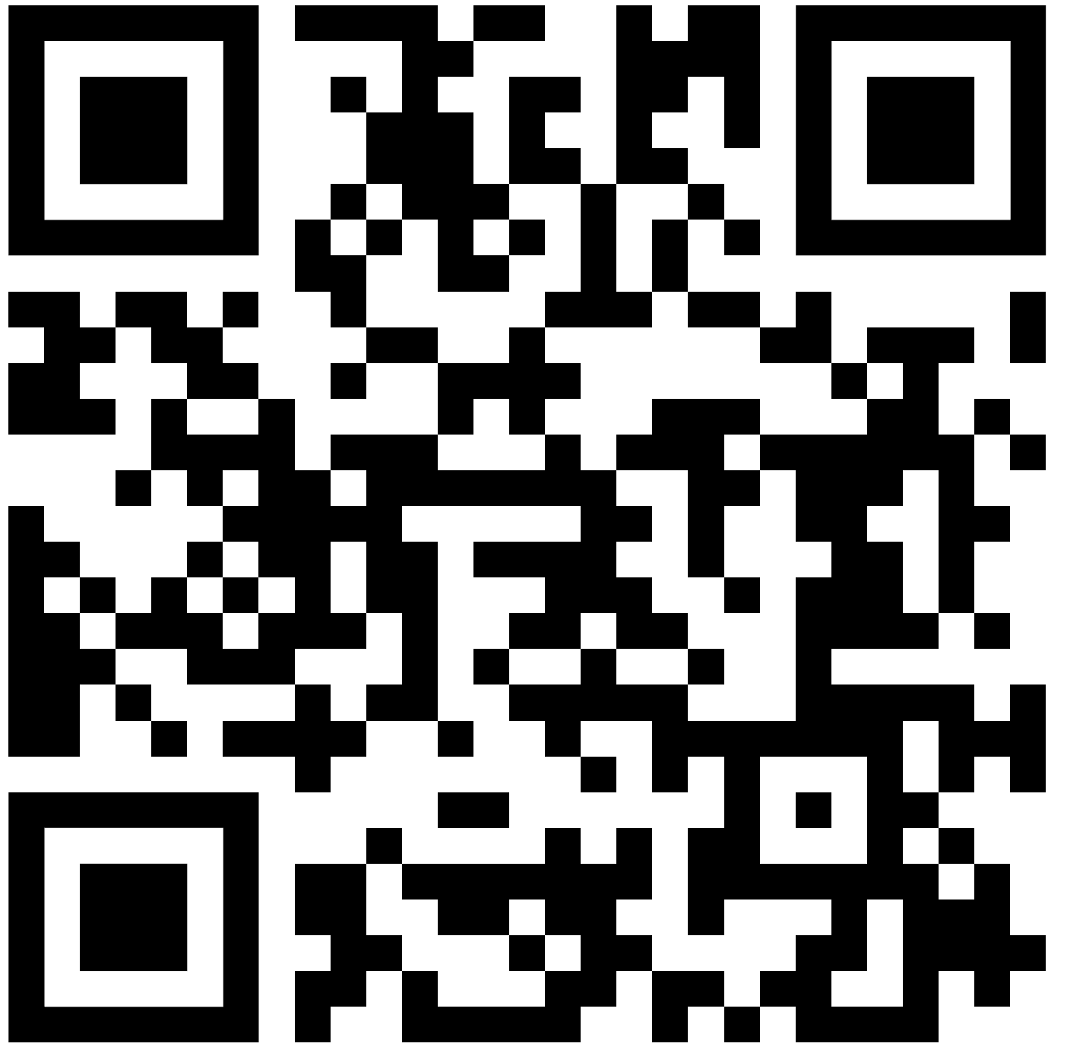
Visit the project website for
Interactive synths, gradient
descent demos and more!

